Slide 1

Smart Ambulance Routing
& Hospital Allocation System
A Java-based project combining Graph Theory · DBMS · Advanced Java · Algorithm Design
BCS401 Algorithm Design
BCS402 Advanced Java
BCS403 DBMS
BCS405B Graph Theory
4th Semester Project

Slide 2
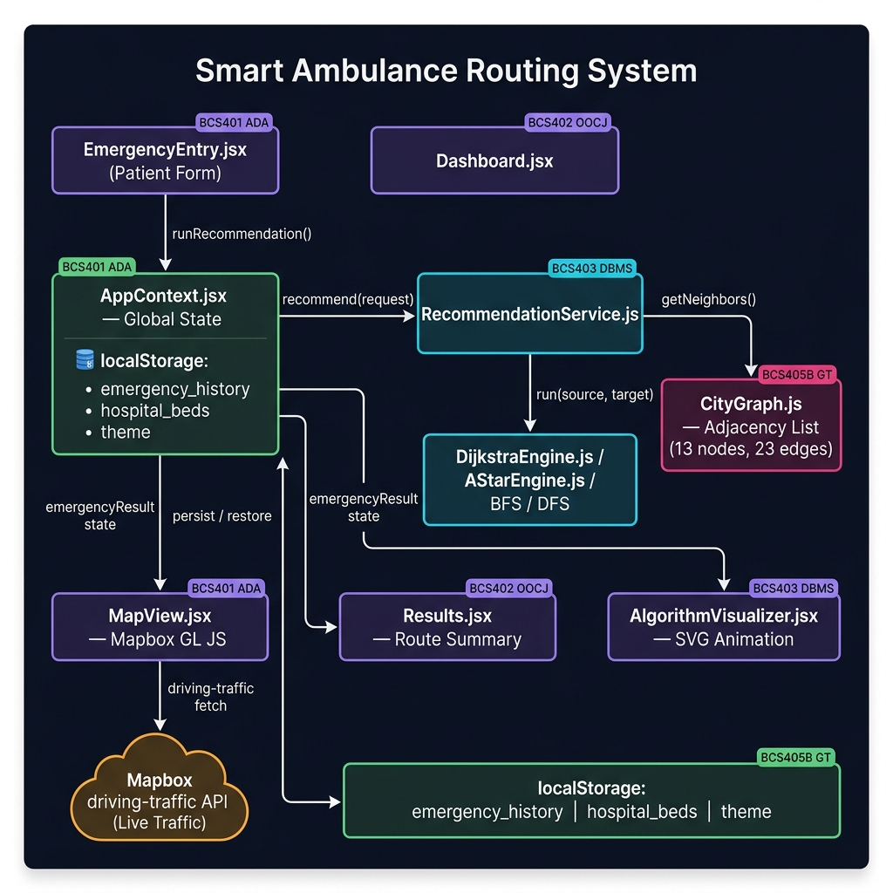
System Architecture
End-to-end component interaction & live traffic data flow
Component Legend
UI Pages (React JSX)
AppContext — Global State
Algorithm Engines (Dijkstra / A*)
CityGraph — Adjacency List
Mapbox driving-traffic API
localStorage Persistence
Data Flow
BCS401 ADA · BCS402 OOCJ · BCS403 DBMS · BCS405B Graph Theory
Form → AppContext → RecommendationService → Dijkstra SSSP → MapView → Mapbox API → Ambulance Animation

Slide 3

What This Project Does
The Problem
Our Solution
In real emergencies, the nearest hospital is chosen — but it may not have ICU, beds, or the right specialization.
Match hospital
Check if the hospital handles the type of emergency (cardiac, trauma, etc.)
Check resources
This leads to delays, wrong allocation, and wasted time.
Confirm if ICU or general beds are available right now
Find best route
The system should find the BEST hospital — not just the closest one.
Use graph algorithms to calculate shortest road path to that hospital
Recommend
Pick the best hospital + a backup option for safety

Slide 4

BCS401 · Algorithm Design & Analysis
What concepts you used and how they appear in this project
Problem Definition
Brute-Force vs. Smart Search
We formally defined the problem: nearest hospital is NOT always the best
Brute-force: check every hospital one by one — works, but slow
We analyzed what factors matter: emergency type, ICU, beds, and road distance
Our system filters hospitals first, then finds the best route — smarter approach
This is called Requirements Analysis in algorithm design
This comparison shows algorithm efficiency
Why Dijkstra? (Algorithm Justification)
Time Complexity Discussion
Roads have different distances (weights) — so you need a weighted path algorithm
BFS / DFS: O(V + E) — visits every node and edge once
Dijkstra always finds the shortest path in a weighted graph
Dijkstra: O((V + E) log V) with a priority queue
BFS works on unweighted graphs; Dijkstra works when weights matter — like real roads
This shows algorithmic thinking

Slide 5

BCS402 · Advanced Java
What concepts you used and how they appear in this project
Object-Oriented Programming (OOP)
Classes · Packages · Encapsulation
We will build project with proper classes and packages. Patient, Hospital, EmergencyRequest, CityGraph — each class has one clear job. This is OOP encapsulation and separation of concerns.
Java Collections Framework
HashMap · ArrayList · PriorityQueue
The graph uses an adjacency list built with HashMap and ArrayList. The recommendation engine uses PriorityQueue for Dijkstra. These are real-world Java Collections in action.
Swing UI (Graphical User Interface)
JFrame · JPanel · ActionListener · Event Handling
MainFrame is the Swing window. It has input fields for patient, dropdowns for emergency type and location, and a results panel. This is event-driven Java GUI programming.
JDBC – Database Connector
JDBC · PreparedStatement · Connection · ResultSet
You prepared a JDBC connector class so the project can talk to a MySQL database later. For now, SampleDataFactory provides test data — JDBC replaces it in the next version.

Slide 6

BCS403 · Database Management System (DBMS)
What concepts you used and how they appear in this project
ER Diagram
Database Tables Designed
We draw an Entity-Relationship diagram showing Patient, Hospital, EmergencyCase, and how they connect. This is the foundation of database design.
patients
Stores patient name and emergency details
emergency_cases
Records each ambulance call
Relational Schema & Normalization
hospitals
Hospital info and location
We convert the ER diagram into tables. Then normalized them up to 3NF — removing duplicate data and keeping each table focused on one topic.
hospital_specializations
What each hospital can treat
hospital_resources
Bed and ICU availability
location_nodes
Places/intersections on the map
SQL Queries
road_edges
Roads between locations with distance
Sample queries: SELECT hospitals by specialization, UPDATE bed count after allocation, INSERT a new emergency case. These show real database usage.
allocations
Records which hospital was assigned

Slide 7

BCS405B · Graph Theory
What concepts you used and how they appear in this project
Weighted Graph (City Model)
Adjacency List
BFS – Breadth First Search
The city roads are modeled as a graph. Each intersection is a Node (vertex). Each road is an Edge. Each road has a weight = distance in km. This is exactly how GPS and map apps work.
We will store the graph using a HashMap of ArrayList in Java. Each node maps to its list of connected roads. This is memory-efficient and fast for sparse road networks.
BFS explores all nearby nodes first before going further. Used to check if a hospital is reachable at all from a location. Works on unweighted graphs.
DFS – Depth First Search
Dijkstra's Algorithm – Shortest Path
DFS goes deep into one path before backtracking. Used as a utility traversal — to explore all hospitals reachable from a starting point. Good for understanding graph connectivity.
The core algorithm of this project. Takes the patient's location and finds the shortest road-path to each valid hospital. It uses a Priority Queue and always picks the lowest-cost next step. This ensures the ambulance takes the fastest possible route to the best hospital.

Slide 8




How All 4 Subjects Work Together
BCS401
BCS403
BCS405B
BCS402
Algorithm Design
DBMS
Graph Theory
Advanced Java
Defines the PROBLEM and justifies WHY Dijkstra is used
Stores hospital data, roads, patients, and allocation history
Models roads as a graph, runs BFS/DFS/Dijkstra to find best route
Builds the full application — OOP, Swing UI, Collections, JDBC
Algorithm Design defines the WHY · Graph Theory does the routing · DBMS stores everything · Advanced Java builds it all

Slide 9
What did we learn?
"This project uses DBMS to store hospitals and roads, Advanced Java to build the application, Graph Theory to model and solve routing, and Algorithm Design to compare and justify the recommendation strategy."
BCS401
BCS402
BCS403
BCS405B
Defined the Problem
Built the App
Designed the DB
Solved the Routing
Smart Ambulance Routing & Hospital Allocation System

